Slide 1
EXTRACELLULAR AND INTERNAL
ENVIRONMENT

Slide 2
Learning Objectives
At the end of the lecture the students should be able to:
Define the extracellular and intracellular fluid.
Describe origin of nutrients in the extracellular fluid.
Explain removal of metabolic end products.
Explain exchnage of water ,nutrients,and other subsrances between the blood and interstitial fluid diffusion through the capillary membrane.
Discuss the interstitium and interstitial fluid fluid imbalance edema.

Slide 3
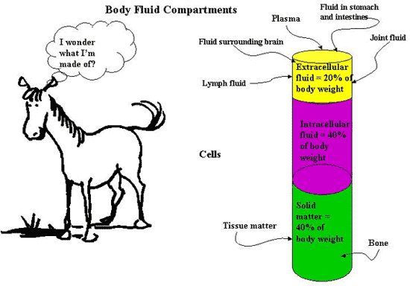
Body Fluids
Water content of the body is divided into
Intracellular compartment (67%)
Inside the cell
Extracellular compartment (33%)
Outside the cell

Slide 4
VOLUME OF BODY FLUIDS IN 70 kg MAN
TOTAL VOLUME
42 L
INTRA CELLUAR FLUID
28 L(ROUGHLY 2/3 OF TBW)
EXTRA CELLULAR FLUID
14 L(ROUGHLY 1/3 OF TBW)
PLASMA
4 L (ROUGHLY ¼ OF ECF)

Slide 5
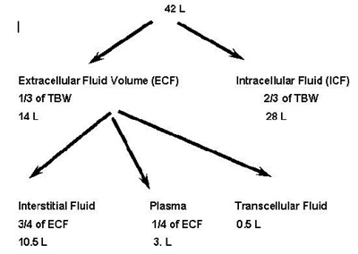
Intracellular Fluid (ICF)
Intracellular Fluid (ICF)
Cytosol or intracellular fluid (or cytoplasmic matrix) is the liquid found inside cells.
It is a complex mixture of substances dissolved in water. Although water forms the large majority of the cytosol
Comprises 2/3 of the body's water.
If body has 60% water, ICF is about 40% of your weight.

Slide 6
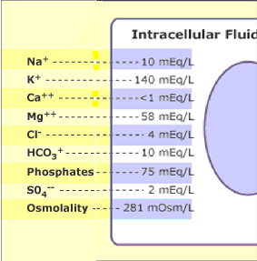
Composition Of Intracellular Fluid
The ICF consists of
Potassium
organic anions
proteins etc. (Cellular Soup!).
  The cell membranes and cellular metabolism control the constituents of this ICF.

Slide 7
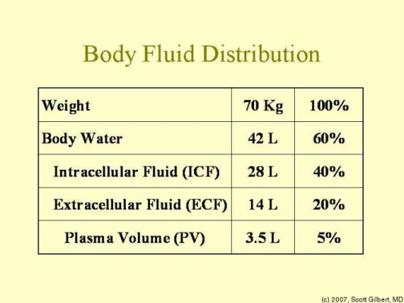
Extracellular Fluid (ECF)
Extracellular Fluid (ECF)
Denotes all body fluid outside of cells.
It is the remaining 1/3 of your body's water.
ECF is about 20% of the body weight.
The ECF is primarily a NaCl and NaHCO3 solution.

Slide 8
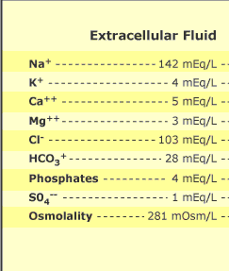
Composition Of Extracellular Fluid
Main Cations:
Sodium (Na⁺ = 136-145 mEq/L)
Potassium (K⁺ = 3,5-5,5 mEq/L)
Calcium (Ca²⁺ = 8,4-10,5 mEq/L)
Main Anions:
Chloride (Cl⁻ = 99-109 mEq/L)
Hydrogen Carbonate (HCO₃⁻ 26 mM)
It is poorer in proteins compared to intracellular fluid

Slide 9
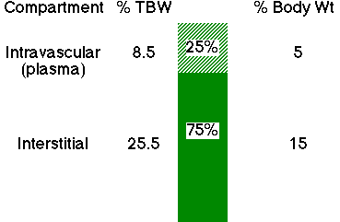
Divisions Of ECF
The ECF is further subdivided into three sub-compartments:
Interstitial Fluid (ISF).
Plasma.
Transcellular fluid.

Slide 10
IMPORTANCE
Maintaining ECF volume is critical to maintaining blood pressure
ECF osmolarity is of primary importance in long-term regulation of ECF volume
  ECF osmolarity maintained mainly by NaCl balance:
    intake: 10.5g/d output: 10g/d in urine

Slide 11
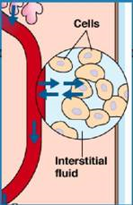
Interstitial Fluid (ISF)
Interstitial Fluid (ISF) surrounds the cells, but does not circulate.
It is the main component of the extracellular fluid
It comprises about 3/4 of the ECF.
Interstitial fluid is found in the interstitial spaces, also known as the tissue spaces.

Slide 12
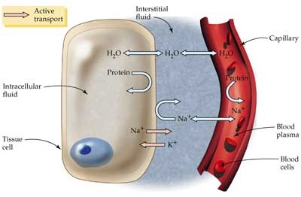
Composition of interstitial fluid
Interstitial fluid consists of:
  Water solvent amino acids
  Sugars
  Fatty acids
  Coenzymes
  Hormones
  Neurotransmitters
  Salts
  Waste products from the cells.
  Lymph is considered a part of the interstitial fluid

Slide 13
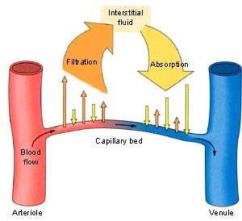
Function Of Interstitial Fluid
Intercellular communication.
  Interstitial fluid bathes the cells of the tissues.
  This provides a means of delivering materials to the cells, intercellular communication, as well as removal of metabolic waste.

Slide 14
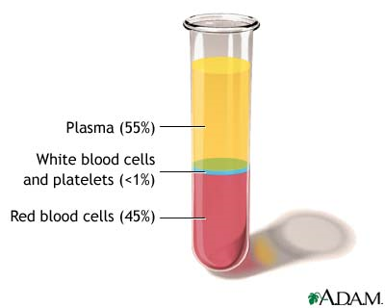
Plasma
Plasma
It is the yellow liquid component of blood in which the blood cells in whole blood are normally suspended
55% of the total blood volume.
It is the intravascular fluid part of extracellular fluid (all body fluid outside of cells)
It makes up about 1/4 of the ECF.

Slide 15
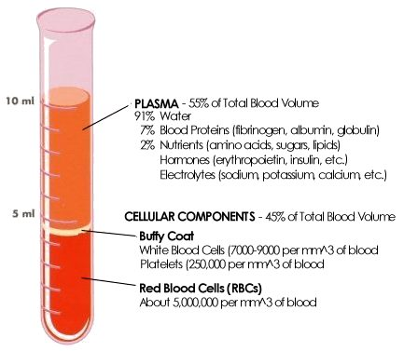
Composition Of Plasma
It is mostly water (90% by volume) and contains
Dissolved proteins
Glucose
Clotting factors
Mineral ions
Hormones
Carbon dioxide.

Slide 16
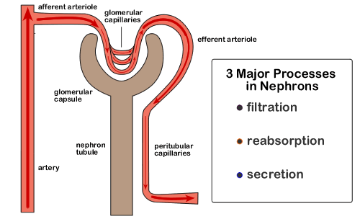
Function Of Plasma
  Plasma being the main medium for excretory product transportation.
Blood serum is blood plasma without fibrinogen or the other clotting factors (i.e., whole blood minus both the cells and the clotting factors).

Slide 17
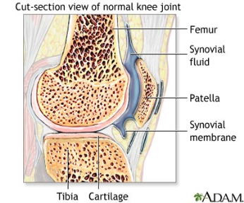
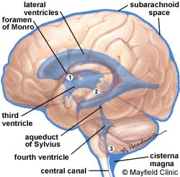
Transcellular Fluid
Transcellular fluid is the portion of total body water contained within epithelial lined spaces.
Smallest compartment.
It is about 2.5% of the total body water.
Examples
  Cerebrospinal fluid
  Ocular fluid
  Joint fluid
  Bladder urine

Slide 18
Composition Of Transcellular Fluid
Due to the varying locations of transcellular fluid, the composition changes dramatically.
Some of the electrolytes present are:
  Sodium ions.
  Chloride ions.
  Bicarbonate ions.

Slide 19
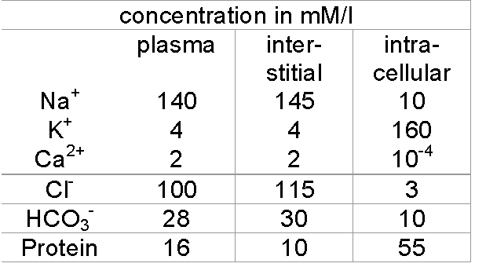
Concentrations of ions

Slide 20
REGULATION OF FLUID
Body Fluids and Fluid Compartments
Why do we care about this?
  ECF volume
  Osmolarity

Slide 21
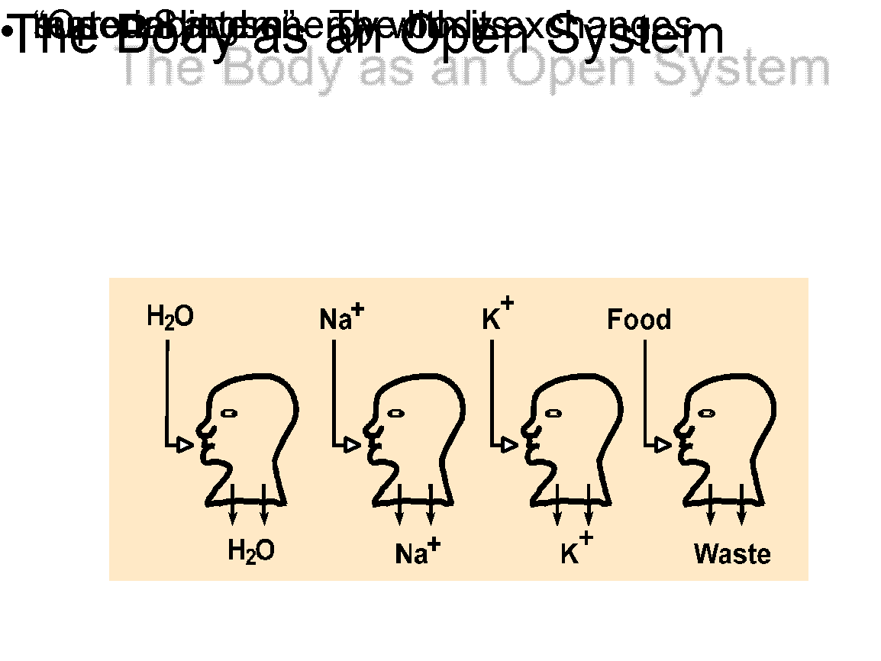

Slide 22
Electrolyte (Na⁺, K⁺, Ca⁺⁺) Steady State
Amount Ingested = Amount Excreted.
Normal entry: Mainly ingestion in food.
Clinical entry: Can include parenteral administration.
Notes:
7
7

Slide 23
Electrolyte losses
Renal excretion
Stool losses
Sweating
Abnormal routes: e.g.. vomit and diarrhea
Notes:
8
8

Slide 24
Net Osmotic Force Development
Semipermeable membrane
Movement of some solute obstructed
H₂O (solvent) crosses freely
End point:
  Water moves until solute concentration on both sides of the membrane is equal
  OR, an opposing force prevents further movement
Notes:
34
34

Slide 25
Osmotic Concentration
Proportional to the number of osmotic particles formed: Osm/L = moles x n (n, # of particles in solution)
Assuming complete dissociation:
  1mole of NaCl forms a __ osmolar solution in 1L
  1mole of CaCl₂ forms a __ osmolar solution in 1L
Physiological concentrations:
  milliOsmolar units most appropriate
  1 mOSM = ___ osmoles/L
e.g. 1 M NaCl = 2 M Glu in Osm/L
Notes:
37
37

Slide 26
Principles of Body Water Distribution
Body control systems regulate ingestion and excretion:
  constant total body water
  constant total body osmolarity
Osmolarity is identical in all body fluid compartments (steady state conditions)
  Body water will redistribute itself as necessary to accomplish this
Notes:
49
49

Slide 27
Intra-ECF Water Redistribution
Plasma vs. Interstitium
Balance of Starling Forces acting across the capillary membrane
  osmotic forces
  hydrostatic forces
Notes:
50
50

Slide 28
Primary Disturbance:
Increased ECF Osmolarity
Water moves out of cells
  ICF Volume ? Increased or decreases
  ICF Osmolarity? Increased or decreases
Notes:
52
52

Slide 29
Primary Disturbance:
Decreased ECF Osmolarity
Water moves into the cells
  ICF Volume ? Increased or decreases
  ICF Osmolarity ? Increased or decreases
Notes:
53
53

Slide 30
Exchange b/w interstitial fluid and Plasma
If Oncotic pressure changes. For eg. If decreases, it will leads to edema.
Edema is define as, ……..
Solute resposible for maintaining oncotic pressure in plasma is ……?

